Slide 1
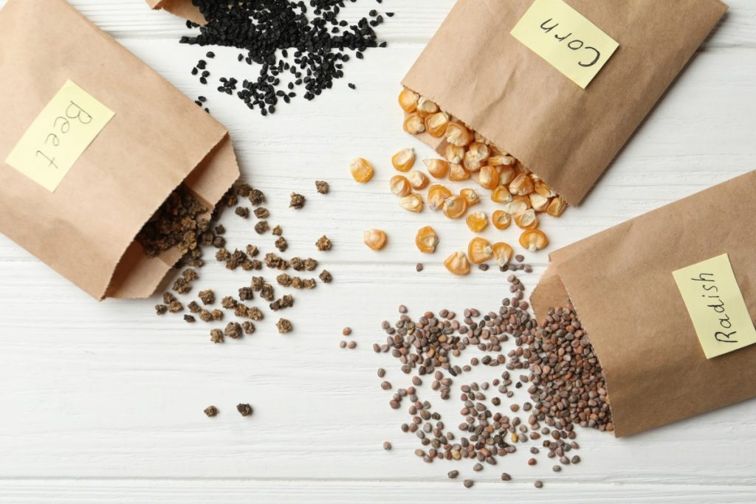
Seed Saving
August 2022

Slide 2


Missouri Valley Extension Master Gardeners

Slide 3
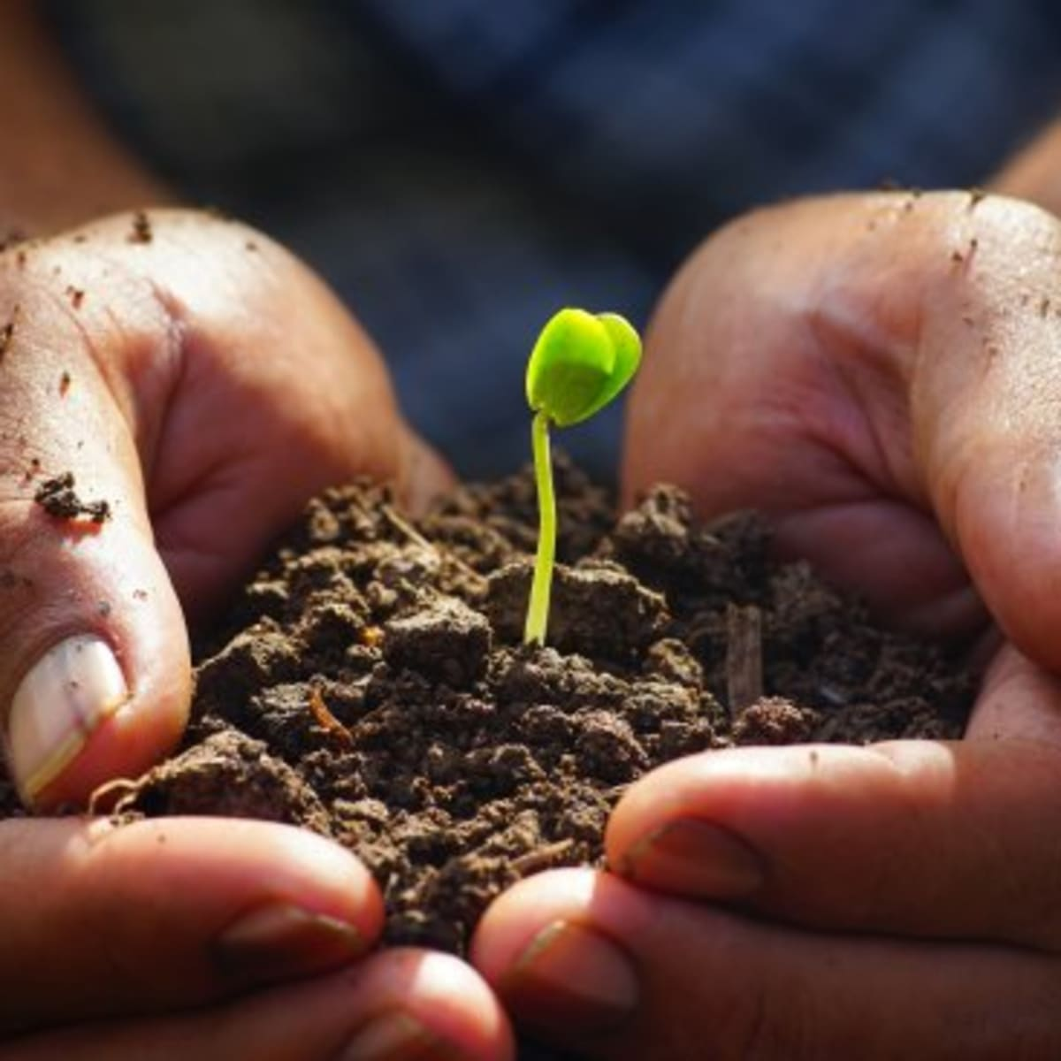
“The entire fruit is already present in the seed.” Tertullian
Why save seeds?
Select for specific traits
Preserve diversity
Save money
Create superb plants

Slide 4
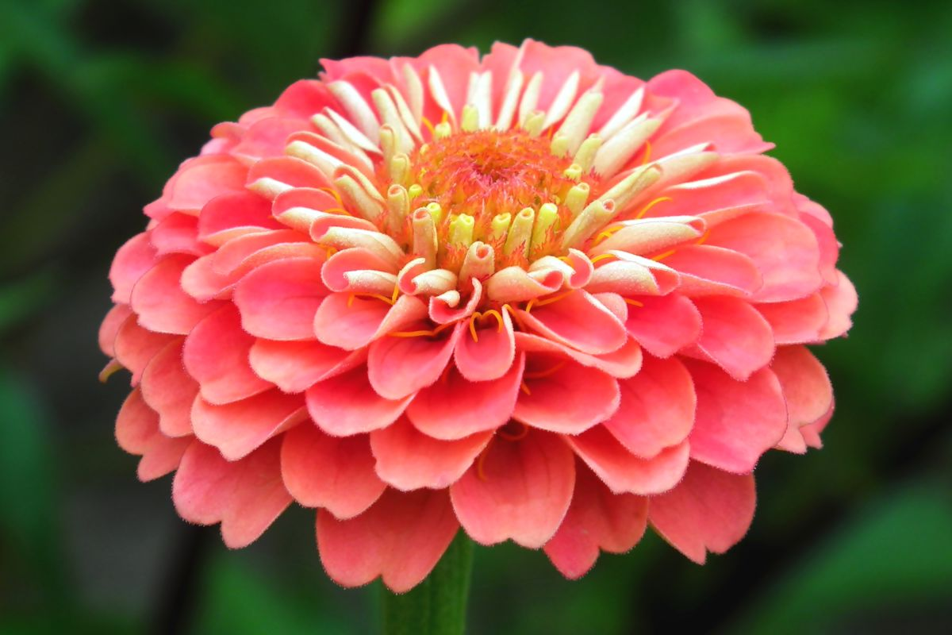
Seed Biology
Plant classification—sexual reproduction begins with flower buds and ends with seed maturation and dispersal
Annuals—cycle is 1 year
Biennials—cycle is 2 years
Perennials—repeat cycle year after year once they are mature

Slide 5
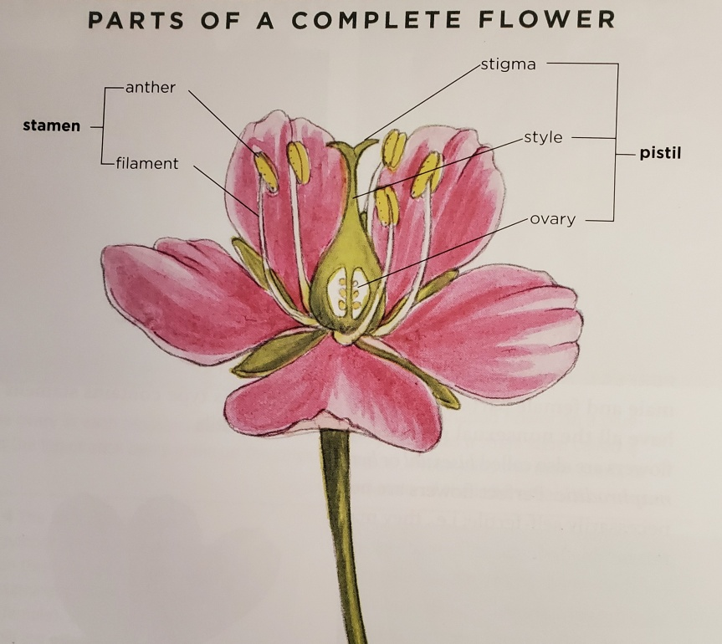
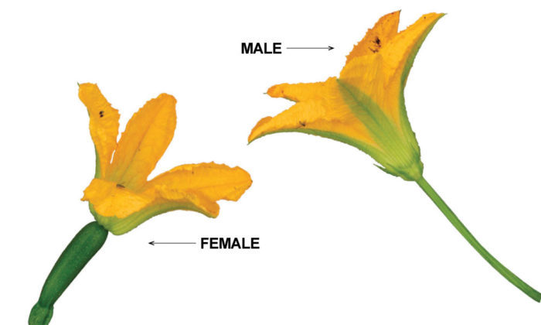
Flowers
Complete flowers have both male (stamen) and female (pistil) parts -tomato, pepper, bean
Incomplete flowers have only one type of sexual organ: -spinach, squash, cucumber
Staminate (male) have only stamens
Pistillate (female) have only pistil
Monoecious: male and female flowers on same plant
Dioecious: male and female flowers on separate plants

Slide 6
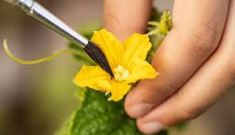
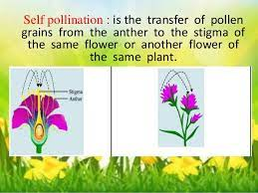
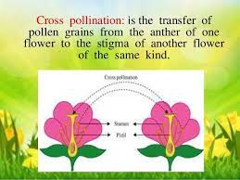
Pollination
Transfer of pollen grains from anther to stigma
Self: from within same flower or another flower on same plant
Cross: from another plant or even another closely related species
Aided by wind, insects, birds (or human intervention)

Slide 7
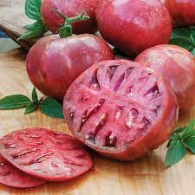
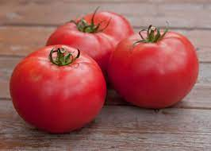
Pollination Terms
Open pollinated: pollinated by natural means
Heirloom: an open pollinated plant that has been grown and shared from generation to generation and has a “story”
Hybrid: a cross between two parent lines with particular characteristics
F1: the first generation of a hybrid cross
Cherokee Purple
Big Boy Hybrid

Slide 8
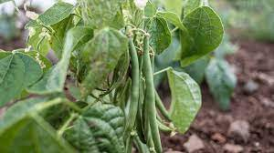
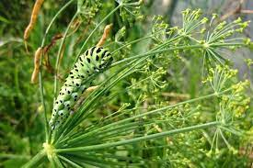
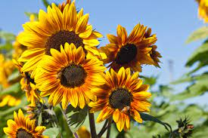
Growing Plants for Seed
Good for beginners:
Beans, leaf lettuce, peas, peppers, spinach, tomatoes
Basil, cilantro, dill
Poppies, snapdragons, sunflowers

Slide 9
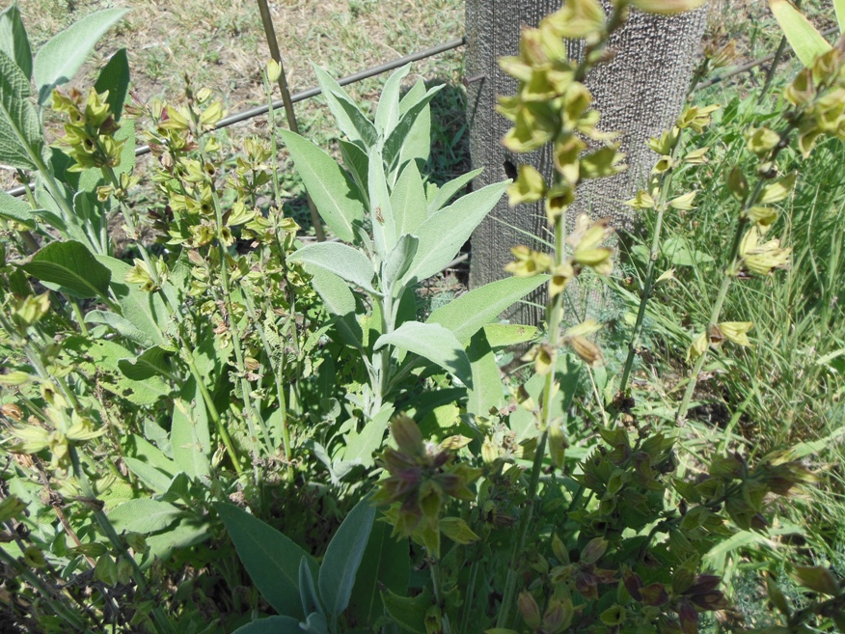
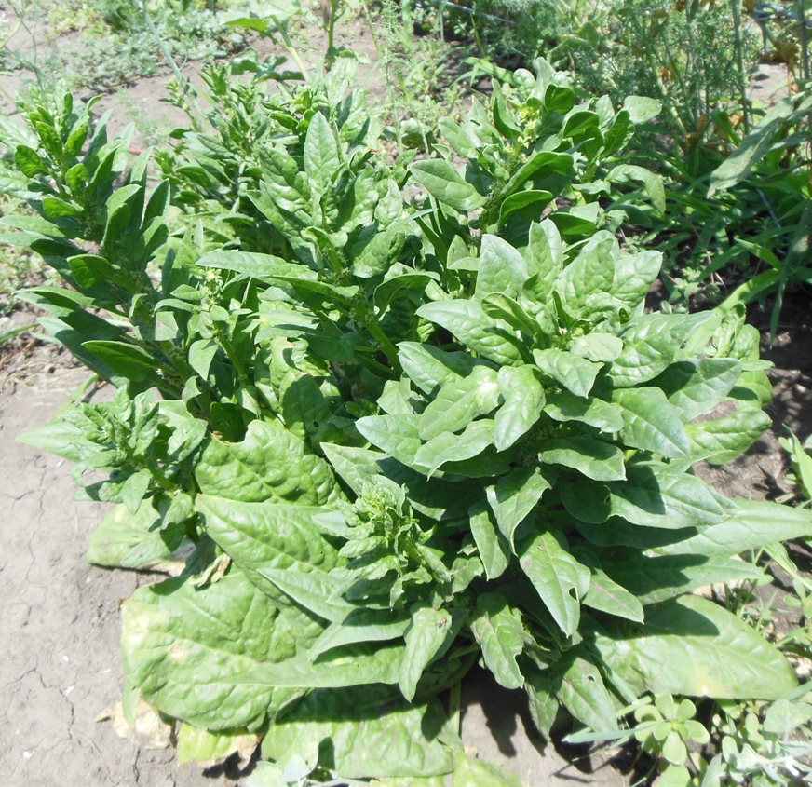
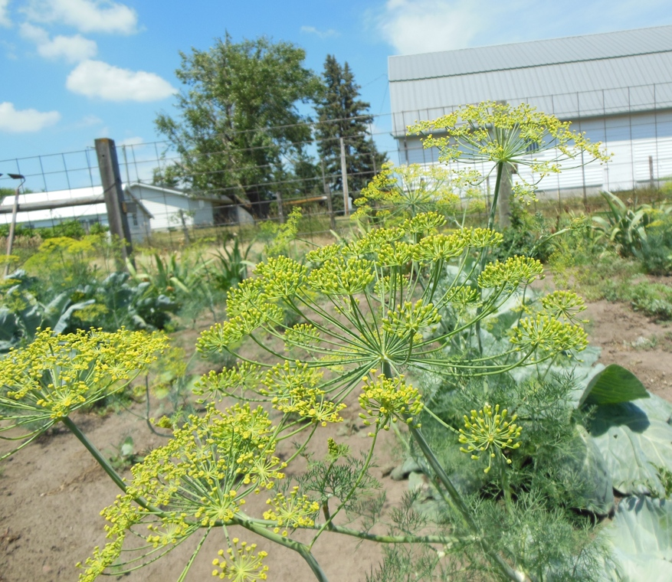
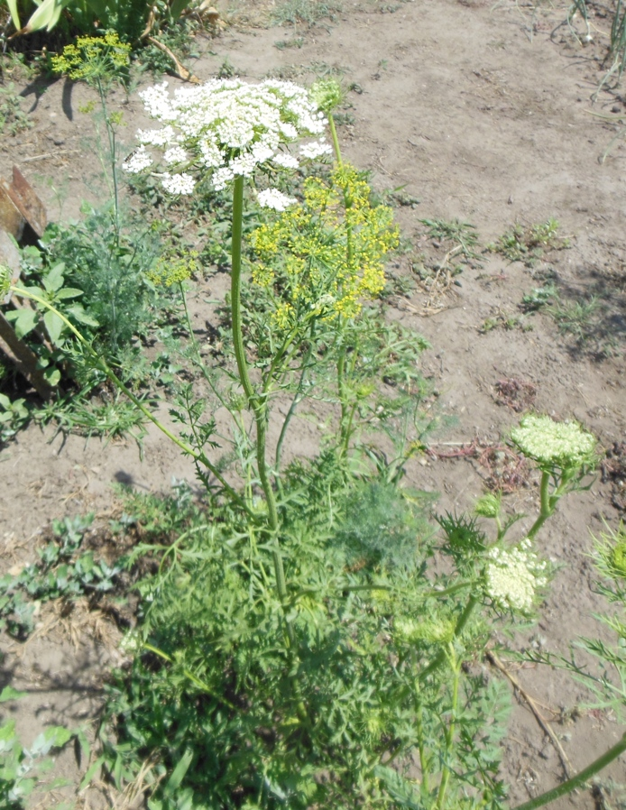
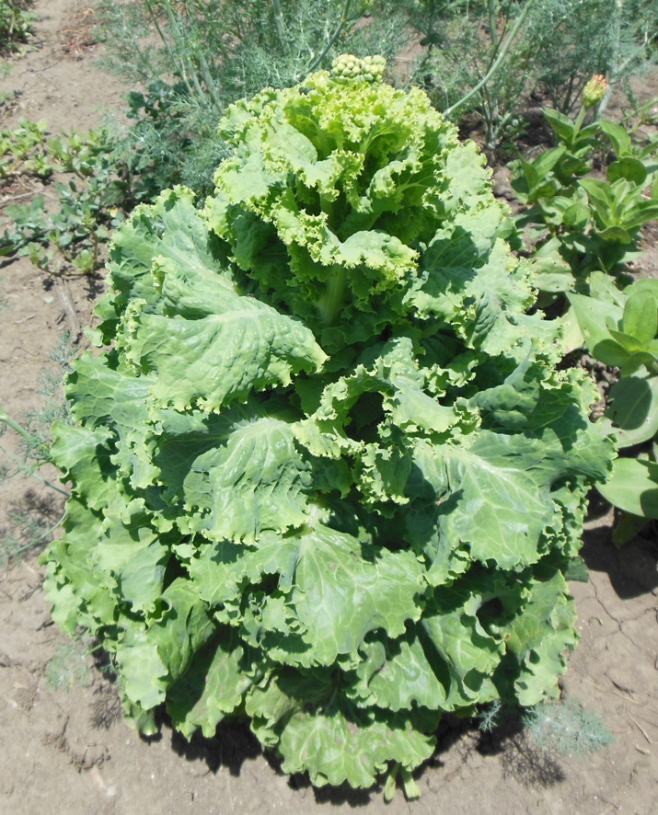
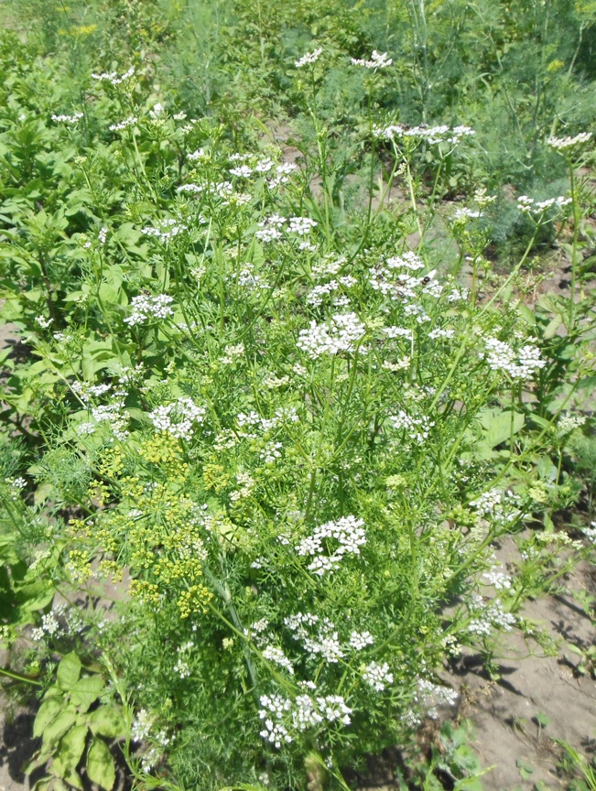
From my Garden
Sage
Spinach
Dill
Carrots
Cilantro/Coriander
Lettuce

Slide 10
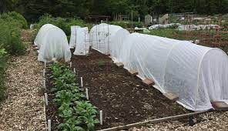
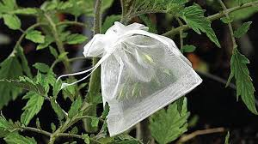
Planning for Seed Saving
Super Spacing—allow 3 or 4 times space between plants
Preventing unwanted pollination
  Distance requirements
  Cover plants
  Bag flowers; hand pollinate
  Stagger planting times

Slide 11
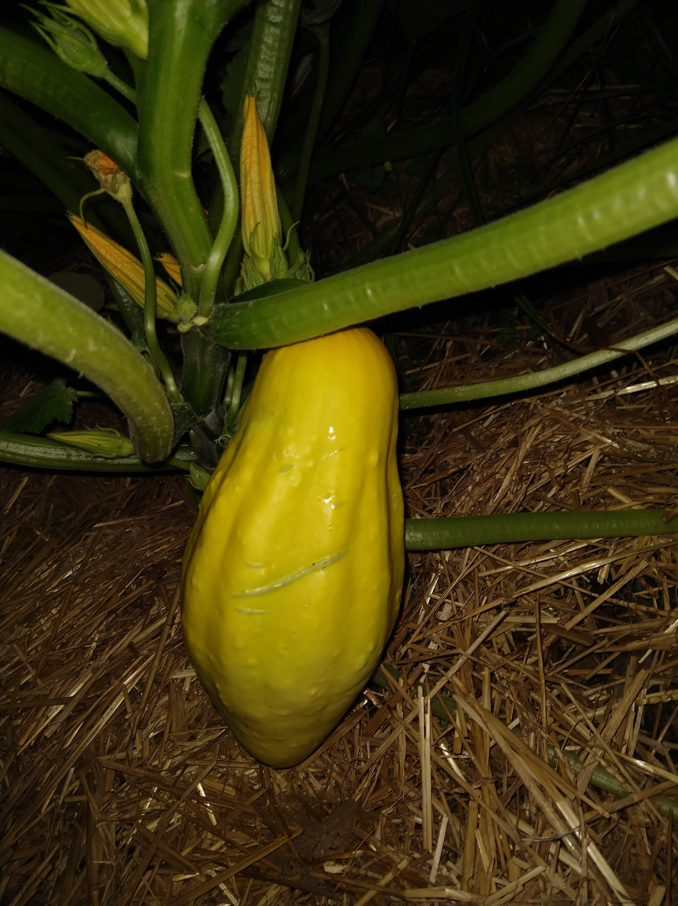
Cucurbits and Cross-pollination
Cucurbita maxima | Cucurbita mixta | Cucurbita mischata | Cucurbita pepo
Amish Pie, Atlantic Giant, Banana, Buttercup, Hubbard, Kabocha, Turk’s Turban | Cushaw | Kentucky Field, Butternut | Connecticut Field, Jack-Be-Little, Jack-o’-Lantern, Acorn, Crookneck, Delicata, Spaghetti, Zucchini
C. Maxima will not cross with C. mixta or C. pepo |  | Will cross with all groups
All varieties will cross within their own species

Slide 12
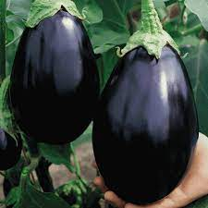
Select your Seed Stock Plants
Select for superior plant performance
Rogue plants with disease or those overwhelmed by insects
Tag plants with desirable characteristics and record favorable traits

Slide 13
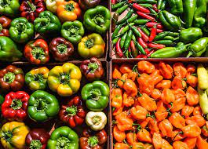
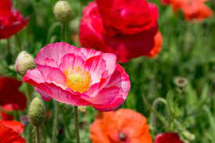
Trait Selection
Time of ripening
Fruit appearance
Crack resistance
Heat level (peppers)
Slow bolting
Flower or foliage color
Resistance to disease or insects

Slide 14
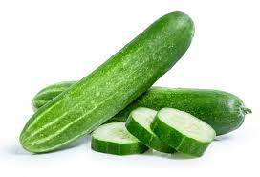
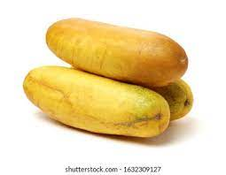
Time to Harvest
Horticultural ripeness: stage at which we eat plant
Physiological ripeness: when seeds have ripened
Too early—lower seed quality
Too late—may lose seeds to shattering or rot
Be guided by how process works in nature

Slide 15
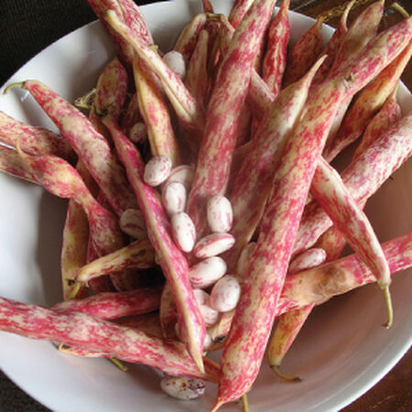
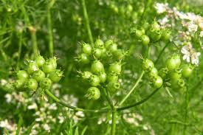
Dry-fruited Crops
Maturity indicators
Color
Onset of drying
Beginning of seed dispersal
Seed hardness

Slide 16
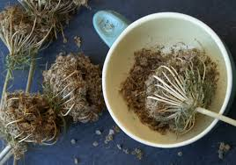
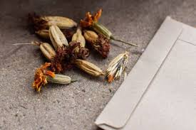
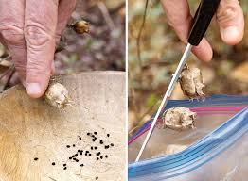
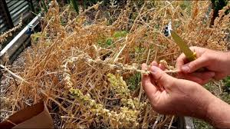
Collecting & Drying Seeds
Collect individual seed heads, branches, or fruits
Allow to dry in warm place
Clean: separate seeds from other material
Thresh: shake, rub, shell, or strip stalks
Screen through colanders, screens, etc
Winnow: use air to separate chaff from seeds
Carrots
Marigolds
Poppy seed
Spinach

Slide 17
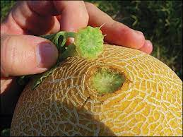
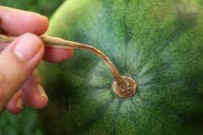
Fleshy-fruited Crops
Maturity Indicators
Color
Ease of detachment from plant
Dryness of stem
Increase in size
Prior to rot

Slide 18
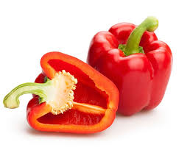
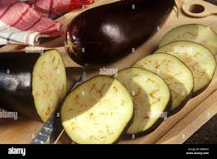
Processing Seeds
Cut open or crush fruit
Tomatoes, peppers, cantaloupe, pumpkins: scoop out & remove by hand
Eggplant: process chunks in food processor
Rinse seeds in colander to remove pulp
Spread on screens or coffee filters to dry completely

Slide 19
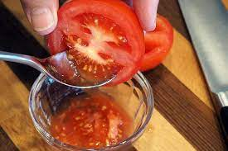
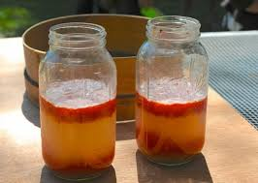
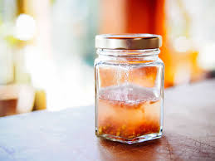
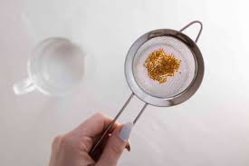
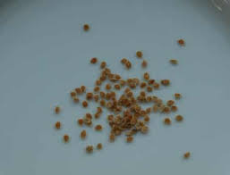
Special Process: Fermentation
1. Extract seeds from tomatoes
2. Ferment in a warm place 2-3 days, stir
3. Fermentation complete when seeds sink
4. Decant, rub & rinse
5. Dry

Slide 20
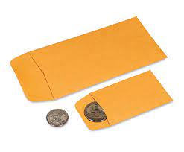
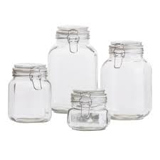
Storing Seeds
Dry thoroughly—spread in thin layers and place where good air flow up to 2 weeks
Store in paper, cloth bags, glass jars
Label with variety name
Keep seeds cool, dry and dark
Long term: refrigerator or freezer

Slide 21
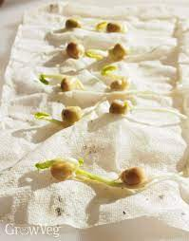
Check germination
Use wet paper towels or seed starting mix
Count out 10 seeds
Stratify or scarify if needed
Keep seeds moist
Keep record of seeds sprouted
Sprouted seeds may be planted in potting soil

Slide 22
Bibliography
Buttala, Lee & Siegel, Shanyn. The Seed Garden
Gough, Robert & Moore-Gough, Cheryl. The Complete Guide to Saving Seeds
Steil, Aaron. Preserve your Vegetable and Flower Seeds for Next Year, ISU

