Slide 1
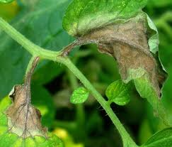
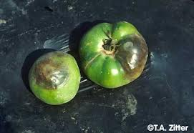
Integrated Pest Management
& Chemical Safety
By Diana Klassy
South Dakota Master Gardener
Certified Private Applicator by the Maryland Department of Agriculture

Slide 2
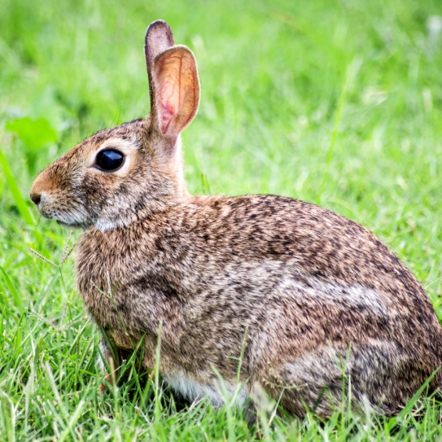
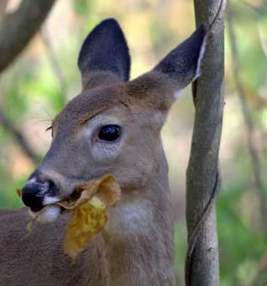
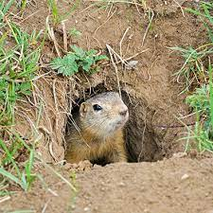
What is Integrated Pest Management?
IPM is a decision making process that utilizes regular monitoring to determine if and when treatments are needed.
A pest management strategy that utilizes a wide range of pest control methods or tactics.

Slide 3
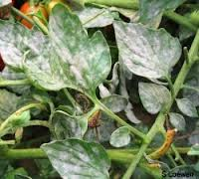
Why Practice IPM?
IPM helps to keep a balanced ecosystem
Sometimes pesticides can be ineffective
IPM can save money
IPM promotes a healthy environment

Slide 4
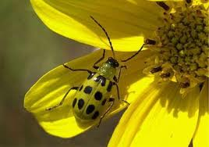
5 Major Steps of IPM
1. Identify the Pest; whether to treat
2. Monitor Pest to be Managed; when to treat
3. Develop the Pest Management Goal; how to treat
4. Implement the IPM Program
5. Record and Evaluate Results

Slide 5
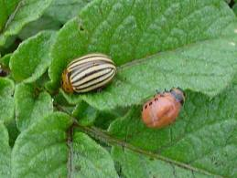
The Four Main Groups of Pests
Invertebrates (insects, mites, ticks, spiders, snails, & slugs)
Disease agents or pathogens (bacteria, viruses, fungi, nematodes, parasitic microorganisms, and other microorganisms)
Weeds (undesirable plants)
Vertebrates (birds, reptiles, amphibians, fish, and rodents and other animals)

Slide 6
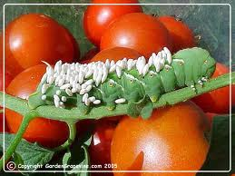
Pest Management Methods
Natural controls (no action)
Applied controls
  Biological control
  Mechanical control
  Cultural control
  Chemical control
  Host resistance or genetic control

Slide 7
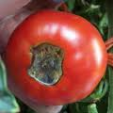
Closer look at Pest Management Methods
Mechanical (Physical) control
Cultivation
Exclusion (barriers)
Trapping
Cultural control
Cultural practices : mulching, fertilizing, irrigation, etc.
Sanitation : weed control, remove and destroy diseased plant material

Slide 8
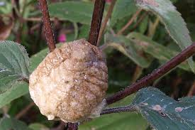
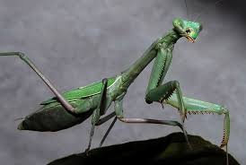
Cultural Control
Environment
Host Plant
Pest
The goal is to alter the environment, the condition of the host plant or site, or the behavior of the pest to prevent or suppress an infestation.

Slide 9
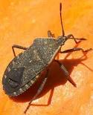
4. Implement the IPM Program
  Follow these steps prior to implementing:
    Identify pest
    Set up monitoring program
    Know the pest level that triggers control
    Know what control methods are available
    Evaluate the benefits and risks of each method
  Select the methods that are most effective and the least harmful to people and the environment
  Use several methods when possible and use them correctly!

Slide 10
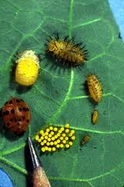
5. Record and Evaluate Results
  Extremely important!
  Consider how well your strategies work and their impact on the environment before implementing them again

Slide 11
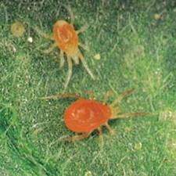
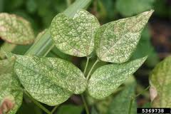
IPM Example: Spider Mites
Observe: stippled leaves
Confirm pest: white paper test
Control method: water blast every 3 days to underside of leaves
Observe results

Slide 12
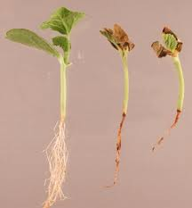
Pesticide and Garden Safety

Slide 13
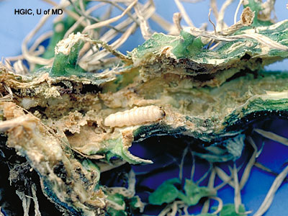
Chemical Controls
Pesticide-any material applied to plants, soil, water, animals, etc. to kill, attract, repel, regulate, or interrupt the growth and mating of pests.

Slide 14
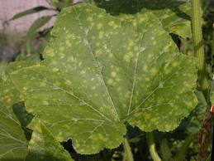
Common Types of Pesticides
Fungicides-control fungi
Insecticides-control insects
Miticides (acaricides)-control mites
Herbicides-controls weeds and other undesirable plants

Slide 15
READ THE LABEL!!!
Before you buy the product
  If you are NOT going to follow the entire label, DON’T BUY IT!
After you get the chemical home to store it
Before every time you use it
  Even if you used I several times before
  THE LABEL IS THE LAW!!!

Slide 16
Pesticide Label: READ BEFORE USE
Trade or Brand Name
Active ingredients & percentage by weight
Types of plants (sites)where it may be used
Pests targeted
How much to use How and when to apply
Required protective clothing & equipment!!!
Signal words, Danger, Warning, Caution
Precautionary statements defining hazards
Emergency & First aid for accidental exposure
Proper storage & disposal of pesticide & empty containers

Slide 17
Pesticide Hazards
Hazard(Risk) =Toxicity X Exposure
Toxicity-the ability of pesticides to cause short term (acute) and long term (chronic) injury
Exposure- occurs when pesticides get into the body through the skin, by inhalation, by swallowing, or by eye contact
Hazard (risk)-the potential or probability for harm (injury, illness, or allergy) to occur because of product toxicity and human exposure

Slide 18
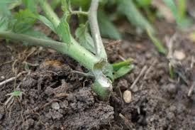
Exposure:
How Pesticides Enter the Body
Dermal (skin) –primary entry route
Eyes –tissues are extremely absorbent
Oral (mouth) – splashing, licking lips
Inhalation (lungs) –protection when mixing

Slide 19
Personal Protective Equipment (PPE)
Refers to clothing and devices worn to protect the body from contact with pesticides
Reduces exposure but does not necessarily eliminate it
Are legally required to follow all PPE instructions that appear on the label
Cautious pesticide handlers may decide to wear additional PPE for increased safety

Slide 20
Protect Your Skin
At a minimum, wear long-sleeve shirt, long pants, and socks with shoes
Chemical resistant gloves, especially when mixing concentrated solutions
Proper footwear (no leather or cloth)
Hat or head covering
Chemical resistant apron
(when mixing chemicals)

Slide 21
Final Points
Always read and Follow the Label!
Keep chemicals in original containers
Store pesticides in a locked cabinet
Do not spray when windy, think about drift & when temps are 80 degrees or higher when chemicals can volatilize
For best results spray undersides and tops of leaves
Do not use restricted pesticides unless you have a Certified Pesticide Applicator’s license
Keep a log/calendar of what pesticides were sprayed and when

Slide 22

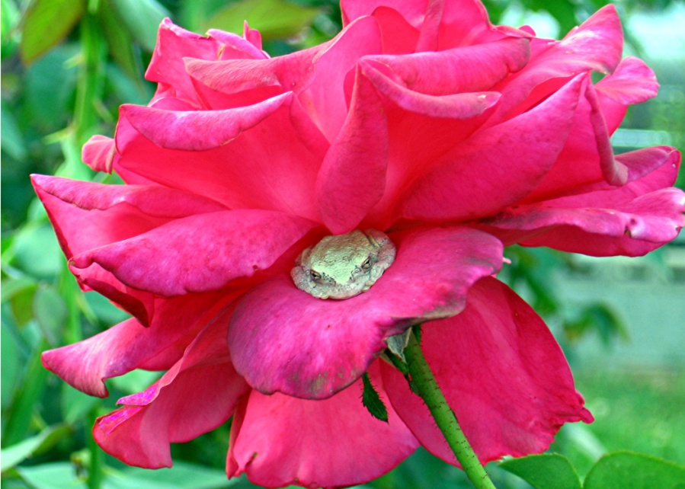
Resources:
Maryland/South Dakota Pesticide Applicator Core Manual
American Rose Society Consulting Rosarian Manual
University of Maryland Master Gardener Handbook

